Slide 1




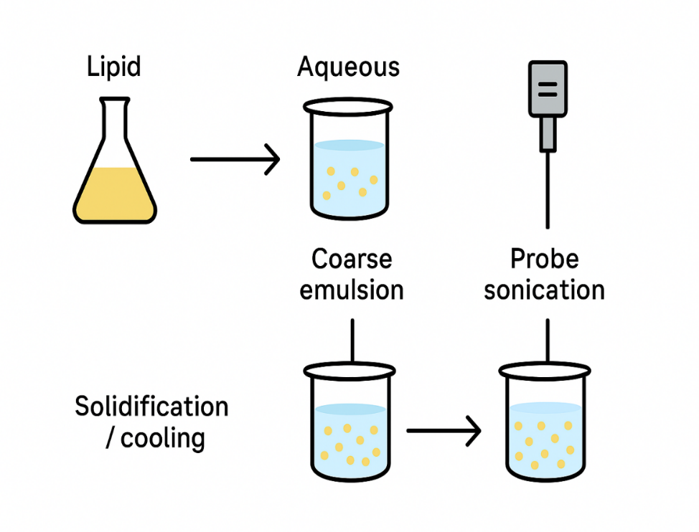
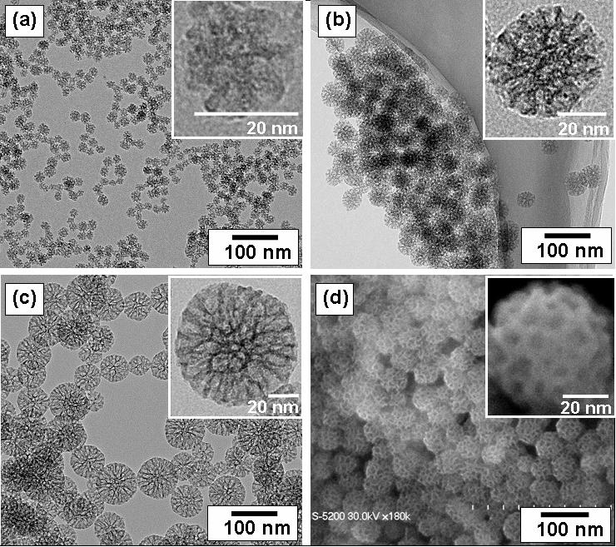
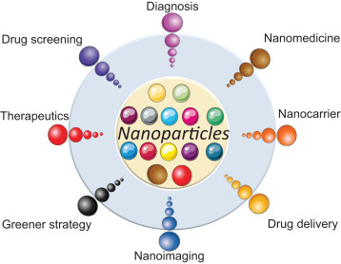
Logo of Institution / University
FORMULATION AND EVALUATION OF HERBAL DRUG LOADED SOLID LIPID NANOPARTICLES
IPC Poster
No.01
Title - 72-100 pt
Presenting Author *
Details of Department/ College/University/ Place
Author details – 36-48 pt
ABSTRACT
METHODOLOGY
Section headings: 40-48 pt
40-48 pt
Diabetes mellitus often leads to oxidative stress, chronic inflammation, and progressive neurological complications. Curcumin, a natural antioxidant and anti-inflammatory compound, offers therapeutic benefits but suffers from poor solubility, rapid degradation, and limited penetration across the blood–brain barrier (BBB).
Mechanical milling: A high-energy process that uses ball milling to reduce particle size.
Physical vapor deposition (PVD): Materials are vaporized and then condensed onto a substrate, creating nanoparticles.
Laser ablation: A high-power laser beam is used to ablate a target material, producing nanoparticles
Provide a brief abstract that summarizes the objectives, methods, key results, and conclusions of your study. This should be about 150-250 words.
Use diagrams or bullet points to describe the methodology, ensuring it is detailed enough to explain the process but concise for readability.
Visual aids such as flowcharts are encouraged.
Body text: 28-36 pt
Body text: 28-36 pt
Figure 2. Method of preparation of Nanoparticle
1 meter
INTRODUCTION
40-48 pt
RESULTS
40-48 pt
DISCUSSION
40-48 pt
Background
Rationale
Objectives
Sem results showed that the particle
The nanoparticle formulation was successfully developed with optimal physicochemical characteristics.
Ionic gelation proved to be a simple, reproducible, and scalable technique for loading both hydrophilic and hydrophobic actives.
Present the introduction with background information on your research, stating objectives and the rationale.
Keep the introduction concise and use bullet points for clarity
Figure 3. SEM results of Nanoparticle
Present your findings using high resolution graphs, tables, and figures. Label each figure clearly (e.g., Figure 1, Figure 2, Table 1, Table 2) and include descriptive captions.
Ensure all visuals are easy to read from a distance and professionally formatted.
Interpret your findings in this section, linking them back to your research objectives. Highlight the significance of your results.
Use concise paragraphs or bullet points.
Body text: 28-36 pt
Body text: 28-36 pt
Body text: 28-36 pt
Table 1. Results of Nanoparticle Characterization
CONCLUSION
40-48 pt
Captions: 24-28 pt
Parameter | Observation | Interpretation
Particle Size (nm) | 150–220 nm (Mean ≈) | Ideal for skin penetration and sustained release
Polydispersity Index (PDI) | 0.20–0.35 | Indicates uniform particle size distribution
Zeta Potential (mV) | –20 to –35 mV | Good colloidal stability, low aggregation
Encapsulation Efficiency (%) | 70–92% | High drug loading efficiency
The nanoparticle formulation was successfully developed with optimal physicochemical characteristics. Ionic gelation proved to be a simple, reproducible, and scalable technique for loading both hydrophilic and hydrophobic actives. The nanoparticles demonstrated high encapsulation efficiency and controlled drug release behavior. Morphological and functional evaluations confirmed the suitability of the nanoparticles for targeted topical delivery.
Figure 1. Uses of Nanoparticle
Provide a concise summary of your main findings and include any recommendations or future directions for your research.
Font – Arial, Calibri, or Helvetica
Body text: 28-36 pt
REFERENCES
40-48 pt
ACKNOWLEDGEMENTS
40-48 pt
Khan I, Saeed K, Khan I. Nanoparticles: Properties, applications and toxicities. Arabian journal of chemistry. 2019 Nov 1;12(7):908-31.
Patil AA. Nanoparticles: properties, applications and toxicities. International Journal of Innovative Science, Engineering and Technology. 2020;8(5).
Singh AK. Engineered nanoparticles: structure, properties and mechanisms of toxicity. Academic Press; 2015 Nov 24.
References: 20-24 pt
The authors express their sincere gratitude to the Faculty of Pharmacy, Ramaiah University of Applied Sciences for providing the necessary laboratory facilities and technical support to carry out this research work. (Sample)
  Include a references section for any key citations (Max 3 References).
1 meter
Body text: 28-36 pt

